Slide 1
Sprint 1
Regression

Slide 2
Sprint 1: Regression
Task: making predictions from data
Core concepts
Algorithms and models
Implementation on real dataset
Assessing a model performance
Overfitting
Bias-variance tradeoff
K-fold cross validation
Simple regression (covered in Statistics sprint)
Gradient descent
Multiple regression
Ridge regression
Lasso regression
Coordinate descent
Wine quality dataset
Sprint 1 - Regression

Slide 3
Sprint 1: Day 1
Task: making predictions from data
Core concepts
Algorithms and models
Implementation on real dataset
Assessing a model performance
Overfitting
Bias-variance tradeoff
Simple regression (covered in Statistics sprint)
Gradient descent
Multiple regression
Wine quality dataset
Sprint 1 - Regression

Slide 4
Sprint 1: Day 2
Task: making predictions from data
Core concepts
Algorithms and models
Implementation on real dataset
Assessing a model performance
Overfitting
Bias-variance tradeoff
K-fold cross validation
Simple regression (covered in Statistics sprint)
Multiple regression
Gradient descent
Ridge regression
Lasso regression
Coordinate descent
Wine quality dataset
Sprint 1 - Regression

Slide 5
Task : making predictions from data
Sprint 3 - Retrieval

Slide 6


Task description
Predicting wine quality (red and white vinho verde wine) from various physicochemical tests
These two datasets were published in [Cortez et al., 2009] and are freely accessible at http://archive.ics.uci.edu/ml/datasets/Wine+Quality
@A. Ponsero
@V. Ponsero
Information about physicochemical property of the wine
Can I predict the wine quality score?
Sprint 1 - Regression

Slide 7
Algorithm: Regression fundamentals
Sprint 3 - Retrieval

Slide 8
Machine learning and regression
Training dataset
x
Feature extraction
ML model
^
y
Input
variables
Prediction
ML algorithm
y
Variable to predict
Quality metric
Sprint 1 - Regression

Slide 9

Regression fundamentals
Predicting wine quality (red and white vinho verde wine) from various physicochemical tests
x₁ = acidity, y₁= quality
x = input variable
y = output that needs to be predicted
Model = expected relationship between x and y
x₂ = acidity, y₂= quality
y
f(x)=w₀ + w₁ x
x₃ = acidity, y₃= quality
with :
w₀ the interception
w₁ the slope and
ε the error
y_{i}= w₀ + w₁ x_{i} + ε_{i}
Regression coefficients
…
x
Sprint 1 - Regression

Slide 10
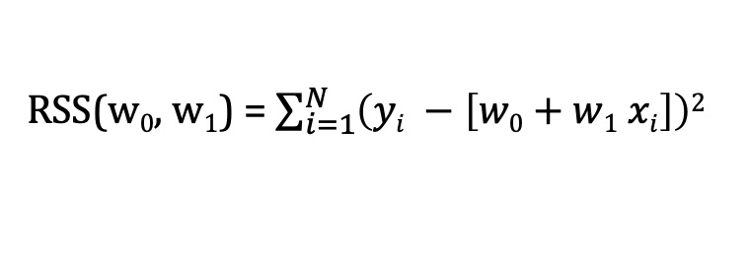
Fitting a line to data
There is a « cost » of using a given line : Residual sum of squares (RSS)
RSS(w₀, w₁) = $\sum_{i=1}^{N}{\left(yi −\left[w0+w1 xi\right]\right)2}$
The « best » line is the one minimizing the cost over w₀ and w₁
X
Sprint 1 - Regression

Slide 11
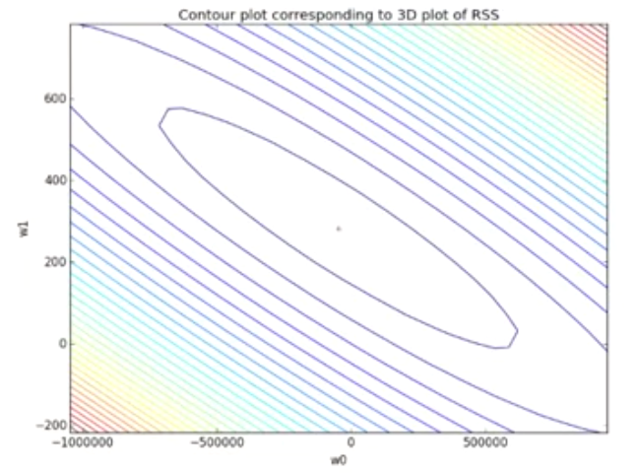
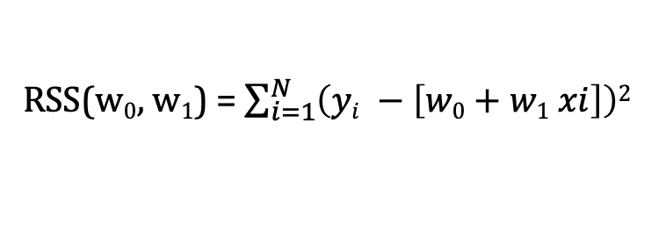
RSS optimization – Gradient descent algorithm
How to find the w₀ and w₁ that minimize the RSS ?
RSS(w₀, w₁) = $\sum_{i=1}^{N}{\left(yi −\left[w0+w1 xi\right]\right)2}$
The gradient descent algorithm allows to find the minima of RSS(w0, w1)
Applied on minimizing RSS, gradient descent algorithm is called OLS (Ordinary least squares)
Sprint 1 - Regression

Slide 12
Machine learning and regression
Training dataset
x
Feature extraction
ML model
w
ML algorithm
y
OLS
Quality metric
RSS
Sprint 1 - Regression

Slide 13
Algorithm: Multiple Linear regression
Sprint 3 - Retrieval

Slide 14
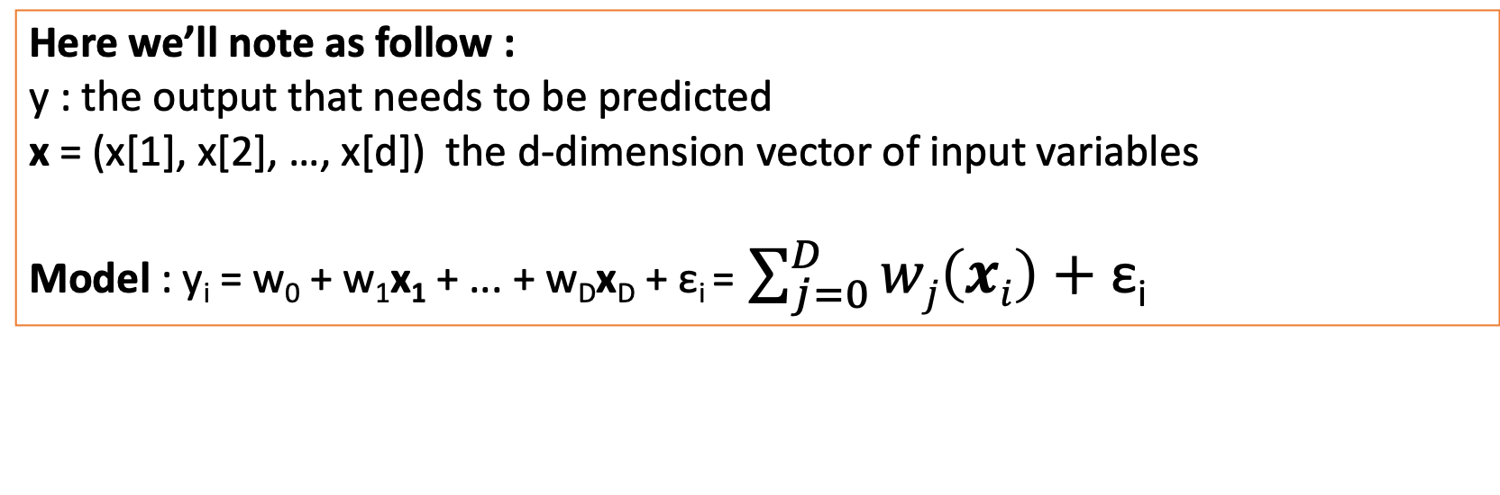
Multiple Linear Regression
In order to improve prediction, we may need to take into account multiple input variables
x₁ = acidity, x₂=chlorides, x₃ = residual sugars …
y₁= quality
Here we’ll note as follow :
y : the output that needs to be predicted
x = (x[1], x[2], …, x[d]) the d-dimension vector of input variables
Model : y_{i} = w₀ + w₁x₁ + ... + w_{D}x_{D} + ε_{i} = $\sum_{j=0}^{D}{wj\left(xi\right)+\text{ε}\text{i}}$
Similarly as simple regression, gradient descent on RSS allows to find the best fit
Sprint 1 - Regression

Slide 15
Concepts: Assessing the performances of the model
“All models are wrong. The practical question is : how wrong do they have to be to not be useful”.
George Box
Sprint 3 - Retrieval

Slide 16
Measuring loss
Loss function:
L(y, f_{w}(x))
What is the cost of using the parameters w to predict y?
actual value
Predicted value
Examples:
Absolute error: L(y, f_{w}(x))) = |y – f_{w}(x)|
Squared error: L (y, f_{w}(x))) = (y – f_{w}(x))²
Sprint 1 - Regression

Slide 17
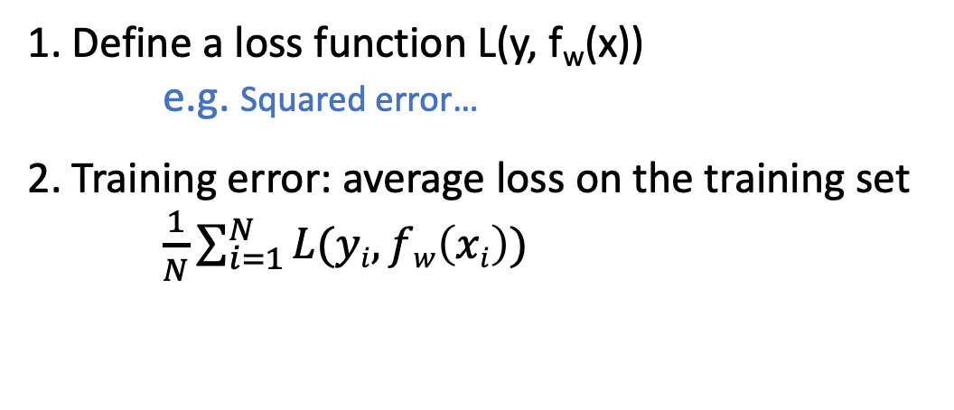
Training error
y
f(x)=w₀ + w₁ x
1. Define a loss function L(y, f_{w}(x))
e.g. Squared error…
2. Training error: average loss on the training set
$\frac{1}{N}\sum_{i=1}^{N}{L(yi, fw\left(xi\right))}$
x
Sprint 1 - Regression

Slide 18
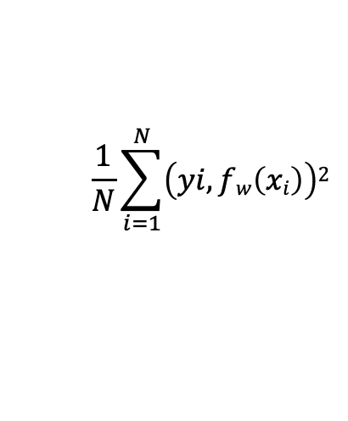
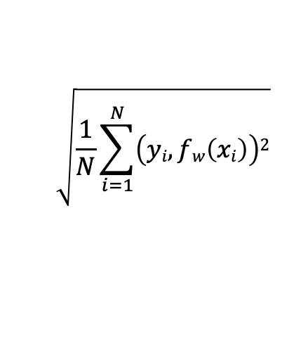
Training error
y
f(x)=w₀ + w₁ x
1. Define a loss function L(y, f_{w}(x))
e.g. Squared error…
2. Training error: average loss on the training set
$\frac{1}{N}\sum_{i=1}^{N}{L(yi, fw\left(xi\right))}$
x
$$\frac{1}{N}\sum_{i=1}^{N}{\left(yi, fw\left(xi\right)\right)2}$$
Using the squared loss:
$$\sqrt{\frac{1}{N}\sum_{i=1}^{N}{\left(yi, fw\left(xi\right)\right)2}}$$
RMSE:
Sprint 1 - Regression

Slide 19
Is Training error a good measure of performance?
Simple linear model
Very complex model
y
y
x
x
High training error
Very low training error
Issue: Training error is overly optimistic because the parameters were fit to the training data
Usually small training error ≠ good prediction!
Sprint 1 - Regression

Slide 20
Test error
How can we approximate the generalization error?
We can compute the error on a set of data NOT included on the training set.
Train
Training set
Model
Assess
Test set
Original dataset
Sprint 1 - Regression

Slide 21
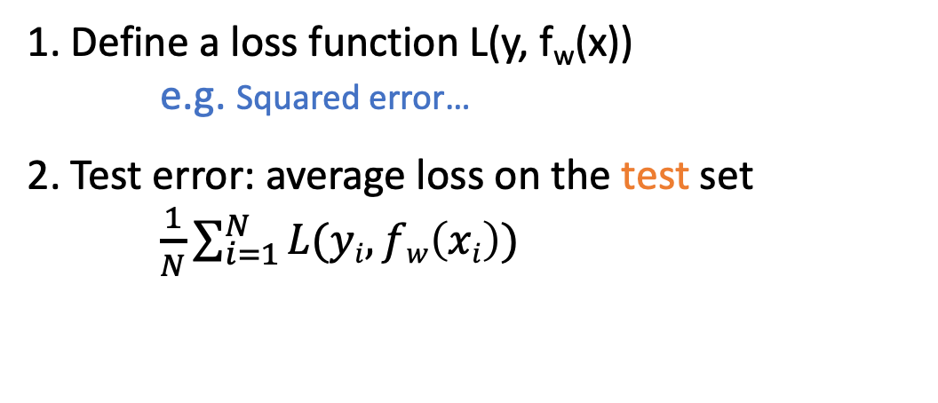
Test error
y
f(x)=w₀ + w₁ x
1. Define a loss function L(y, f_{w}(x))
e.g. Squared error…
2. Test error: average loss on the test set
$\frac{1}{N}\sum_{i=1}^{N}{L(yi, fw\left(xi\right))}$
x
$$\frac{1}{N}\sum_{i=1}^{N}{\left(yi, fw\left(xi\right)\right)2}$$
Using the squared loss:
$$\sqrt{\frac{1}{N}\sum_{i=1}^{N}{\left(yi, fw\left(xi\right)\right)2}}$$
RMSE:
Sprint 1 - Regression

Slide 22
Overfitting?
Test error
Overfitting if:
There exist a model with estimated parameters w’ such that:
Training error (w) < training error (w’)
Test error (w) > test error (w’)
Error
Training error
Model complexity
Sprint 1 - Regression

Slide 23
Implementation: Predicting wine quality
Sprint 3 - Retrieval

Slide 24
Task description
Compute a simple and multiple regression to predict the wine quality
-> Open Jupyter notebook
@A. Ponsero
@V. Ponsero
Information about physicochemical property of the wine
Can I predict the wine quality score?
Sprint 1 - Regression

Slide 25
Algorithm: Polynomial regression
Sprint 3 - Retrieval

Slide 26
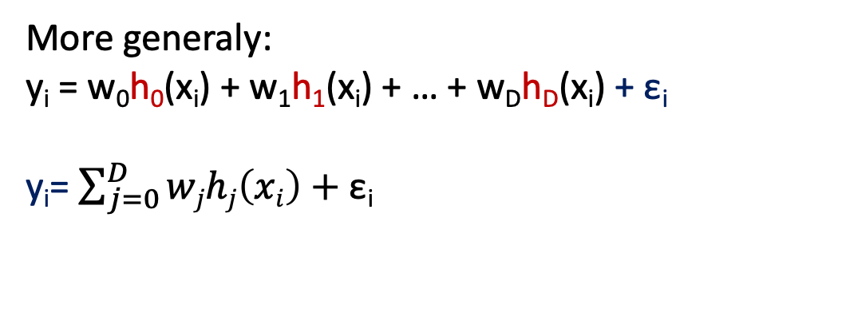
Polynomial regression
Model:
y_{i} = w₀ + w₁ x_{i} + w₂ x_{i}² + … + w_{D} x_{i}^{D} + ε_{i}
y
Treat as different features
(function of the input x)
x
In this example :
Feature 1 = 1 (const)
Feature 2 = x
Feature 3 = x²
…
Feature D+1 = x^{D}
More generaly:
y_{i} = w₀h₀(x_{i}) + w₁h₁(x_{i}) + … + w_{D}h_{D}(x_{i}) + ε_{i}
y_{i}= $\sum_{j=0}^{D}{wjhj\left(xi\right)+\text{ε}\text{i}}$
h_{j} = j^{th} feature
W_{j} = weight associated with the j^{th} feature
Sprint 1 - Regression

Slide 27
Machine learning and regression
Training dataset
x
Feature extraction
h(x)
ML model
w
ML algorithm
y
Quality metric
Sprint 1 - Regression

Slide 28
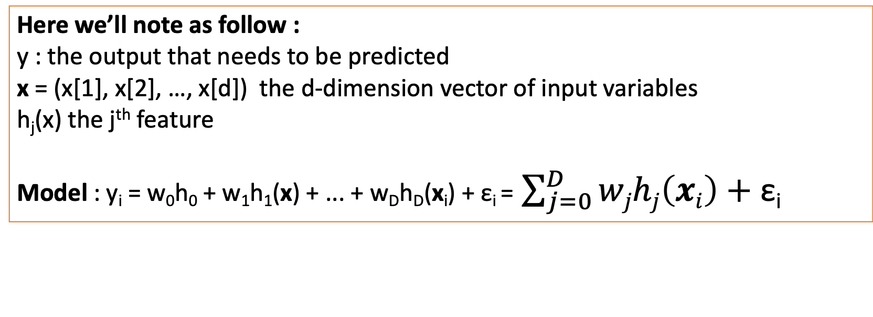
Multiple Regression
In order to improve prediction, we may need to take into account multiple input variables
x₁ = acidity, x₂=chlorides, x₃ = residual sugars …
y₁= quality
Here we’ll note as follow :
y : the output that needs to be predicted
x = (x[1], x[2], …, x[d]) the d-dimension vector of input variables
h_{j}(x) the j^{th} feature
Model : y_{i} = w₀h₀ + w₁h₁(x) + ... + w_{D}h_{D}(x_{i}) + ε_{i} = $\sum_{j=0}^{D}{wjhj\left(xi\right)+\text{ε}\text{i}}$
Similarly as simple regression, gradient descent on RSS allows to find the best fit
Sprint 1 - Regression

Slide 29
Concepts: 3 sources of error
Sprint 3 - Retrieval

Slide 30
3 sources of error
In forming predictions, there are 3 sources of error:
Noise
Bias
Variance
Sprint 1 - Regression

Slide 31
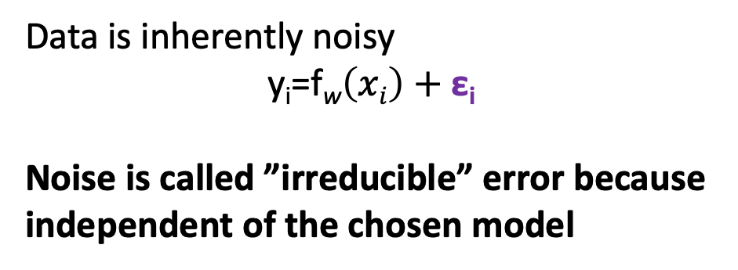
3 sources of error
In forming predictions, there are 3 sources of error:
Noise
Bias
Variance
y
f(x)=w₀ + w₁ x
Data is inherently noisy
y_{i}=f_{w}$\left(xi\right)+\text{ε}\text{i}$
Noise is called ”irreducible” error because independent of the chosen model
x
Sprint 1 - Regression

Slide 32
3 sources of error
In forming predictions, there are 3 sources of error:
Noise
Bias
Variance
Bias contribution:
assessment of how well the model can fit the relationship between x and y.
y
f(x)=w₀ + w₁ x
Low complexity
=
high bias
x
Sprint 1 - Regression

Slide 33
3 sources of error
In forming predictions, there are 3 sources of error:
Noise
Bias
Variance
Variance contribution:
How much do specific fits vary from the expected fit?
y
f(x)=w₀ + w₁ x
High complexity
=
High variance
x
Sprint 1 - Regression

Slide 34
Bias – variance tradeoff
Variance
Best model possible
There is no way to compute the real bias or variance (we don’t have the true model).
But there are ways to optimize the tradeoff.
Bias
Model complexity
Sprint 1 - Regression

